Slide 1
Microsoft Agentic AI Hackathon
Insurance Underwriter Risk/Quote Referral Agent
Team – underwriterriskrefagent
Members:
ranuojha15@gmail.com
gaurav.sharma9@ibm.com
ruvanars@in.ibm.com
1

Slide 2


Hackathon Use Case
Business Challenge:
Underwriters face growing complexity to create a quote for an insurance policy and decide on the referral needed, with thousands of potential referral triggers.
Manual analysis increases operational inefficiency, delays decision-making, and introduces variability in risk assessments.
There is a strategic need to enhance underwriting speed, consistency, and risk evaluation without increasing workload.
How can we assist underwriters to decide if a risk or quote needs to be referred to a colleague for further review?
Problem Statement:
Assist underwriters by predicting risk referrals and highlighting probable referral reasons during the quoting process.
Streamline underwriting workflows to improve turnaround times and decision quality.
2

Slide 3

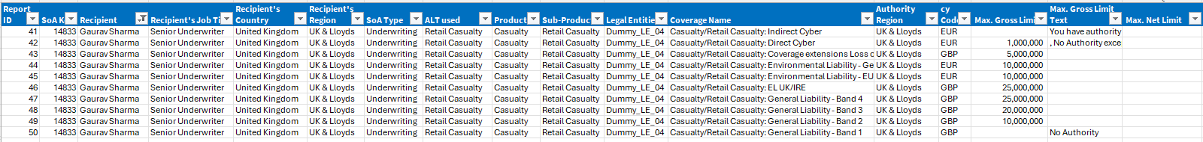

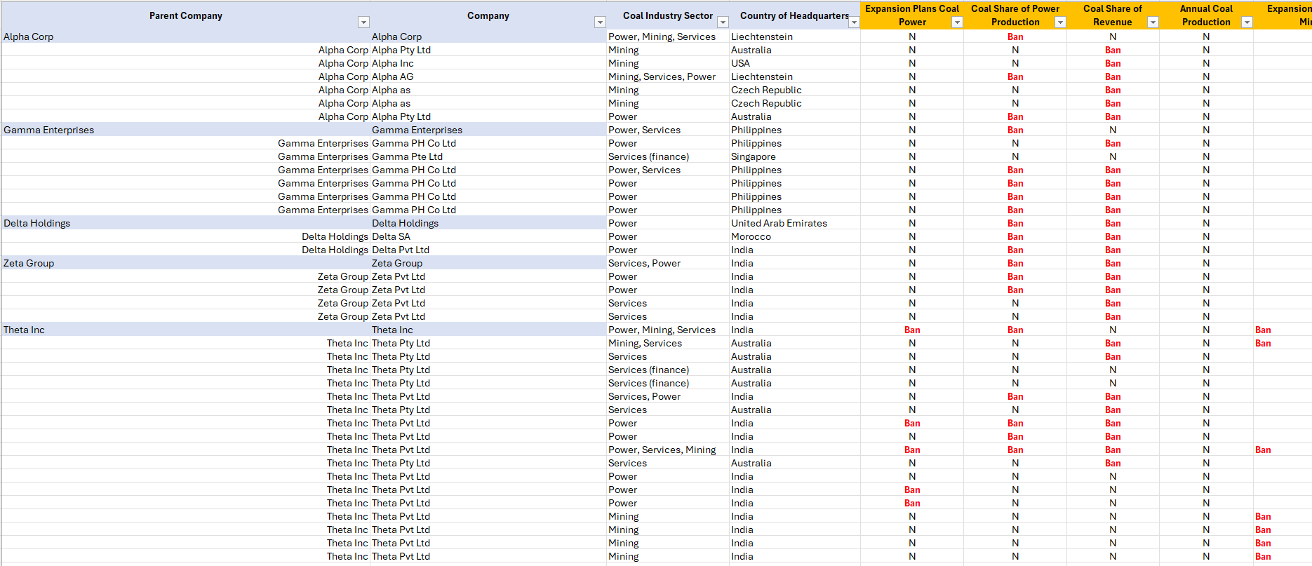
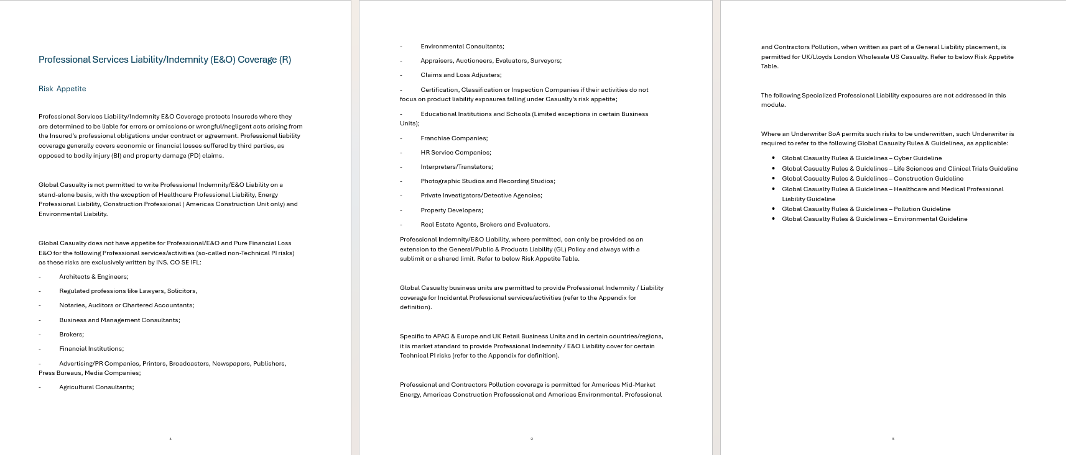
An agentic solution to offer risk referral recommendations to underwriters, which is pre-trained on referral rules and guidelines applicable at both individual underwriters and company level.
Our Hackathon Solution
AI Orchestrator Agent
1
Receives policies and user inputs, decides which agents to engage based on the query type and context, shows output
2
Quote/Policy Agent ( Underwriter level referral check)
Check Policy Coverage guidelines for each underwriter
3
Database Query Agent ( Underwriter level referral check)
Check Policy Authority guidelines for each underwriter
4
Rules & Guidelines Agent ( Company level referral check)
Sustainability rating of Companies
Rules and Guiltiness Document
3

Slide 4
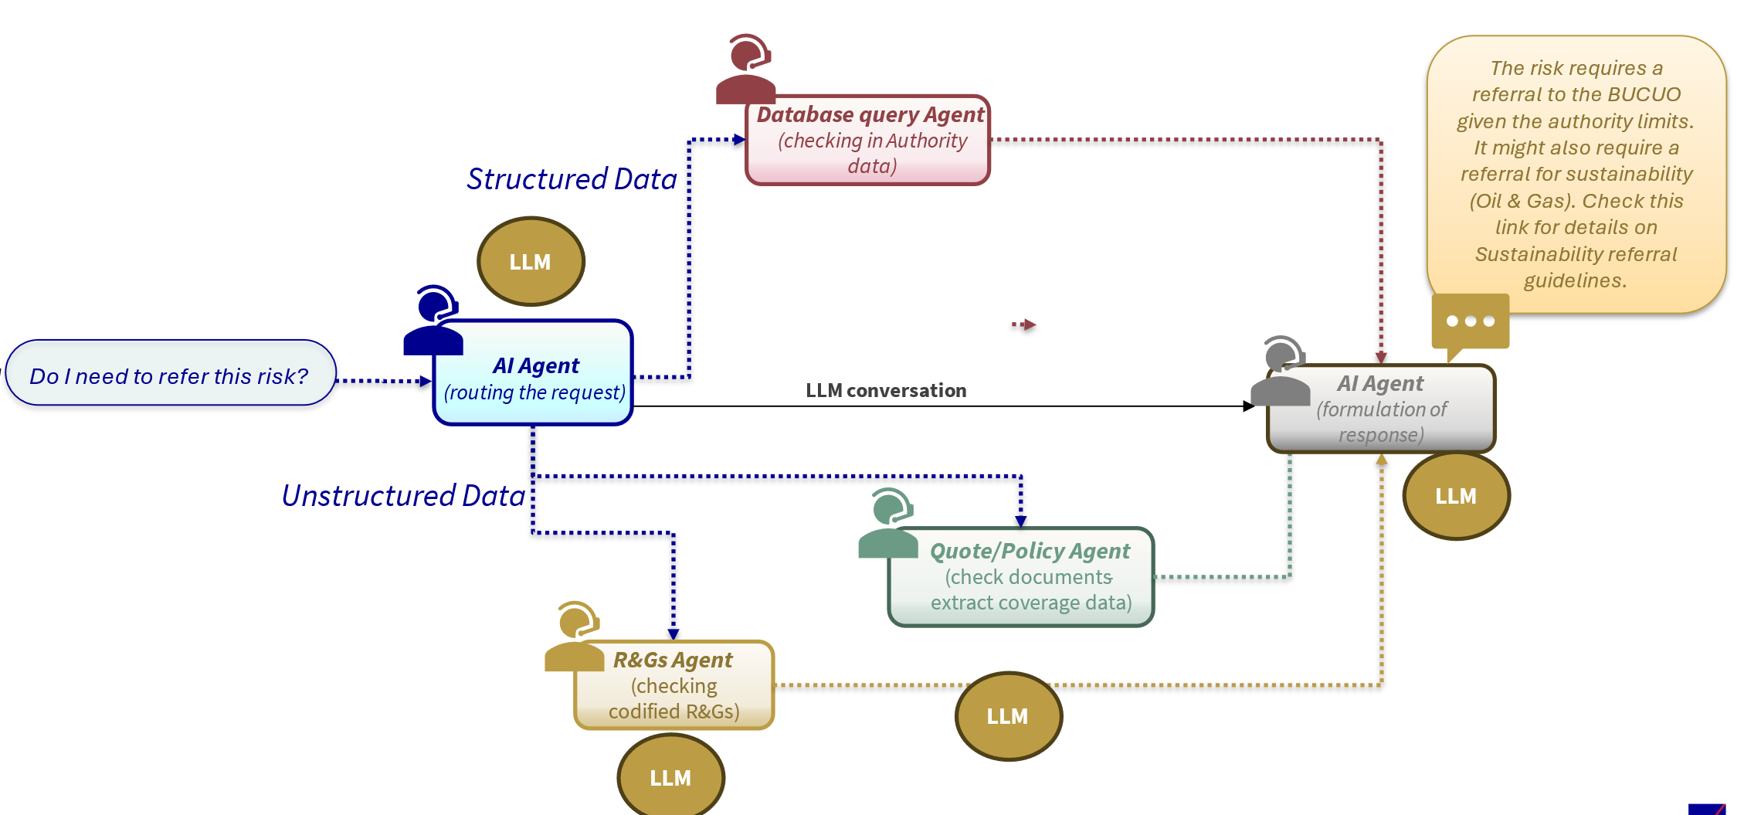
The Hackathon Solution
3
1
5
2
4
1,5
AI Orchestrator Agent
2
Quote/Policy Agent
3
Data Base Query Agent
4
Rules & Guidelines Agent
Function: Receives policies and user inputs, decides which agents to engage based on the query type and context, shows output
Routes the query to: Database Query Agent/ /Quote/Policy Agent / R&Gs Agent as required
Function- Extracts data from policy documents (e.g., sum insured, exclusions).
Maps coverage to potential referral conditions.
Function- Checks authority limits, rules, escalation needs.
Returns structured flags (e.g., over authority threshold).
Function: Reads codified rules/guidelines.
Extracts any special referral conditions (e.g., sustainability, industry-specific rules).

Slide 5

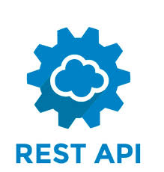





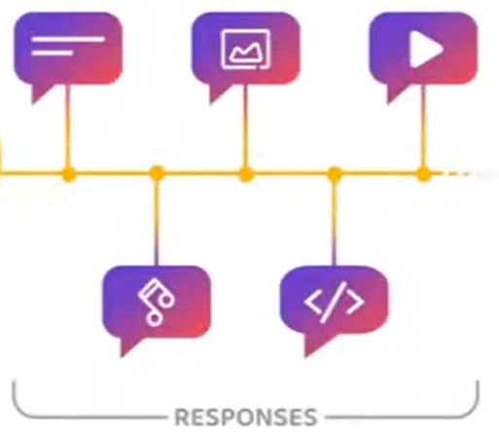


Architecture
Policy Documents
R&G Document
Prompts
User Interface
2
4
Policy Agent
R&G Agent
Orchestrator AI Agent
1
3
DB Agent
Chat GPT
LLM
Responses
Final Response Agent
AI Foundry

Slide 6
Sample questions
 |  | R&G Agent
Prompt/ Question | Quote/Policy Agent | Sustainability list | R&G documents | Database agent
Do I need any referrals for this policy? What referrals are needed? | Yes | Yes | Yes | Yes
Can I perform manuscripting in this policy? |  |  |  | Yes
Can I change the limit for Product Recall coverage to GBP 10,000,000? Any referrals needed? |  |  | Yes | Yes
Are the coverages in the policy aligned with my authority & R&Gs? Anything I need to check? | Yes |  | Yes | Yes

Slide 7
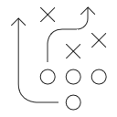



Value Proposition
Agentic AI driven referral automation can unlock thousands of hours in underwriter capacity, strengthen compliance controls, and deliver multi-million-dollar efficiency gains across the global underwriting workforce.
Underwriter Time Savings
Automating referral decisions and enabling workflow automation can reduce the current 30–60 minutes spent per quote on manual referral checks. With approximately 200,000 policies underwritten globally and 2–3 quotes per policy, automating even 50% of this effort represents significant efficiency gains.
Cost avoidance
Underwriters currently spend about one hour per policy for manual control checks, with each underwriter reviewing four policies per year (across 2,000 underwriters). By eliminating 70–80% of this effort, the organization can potentially avoid significant manual costs. At an estimated $150,000 per underwriter, the cumulative savings opportunity is considerable when scaled across the underwriting workforce.
Strengthened Risk and Compliance Controls
Currently, more than 50 different reasons can trigger a referral, varying by jurisdiction, industry, distribution model, and insured product/service. Multiple layers of manual checks introduce the risk of human error. The AI-driven solution will enhance control robustness by automating and strengthening these processes, making controls more preventative rather than sample-based and reactive.
7

Slide 8
Benefit Calculation
60 min per quote
3 quote per policy
Globally 200,000 policies per annum
36 m min/ annum spent in creating quotes/ risks
Assume 75% of this effort goes in reviews and referrals
Assume we automate 50 % of this effort
Total effort saved = 50% of 75% of 6000 hours = 13.5 m min per annum
Assume Avg. underwriter salary $150,000 per annum
Total $ saving = $18.45 m per annum
8

